Slide 1
SECURE DATA HIDING IN IMAGES USING STEGANOGRAPHY
CAPSTONE PROJECT
Presented By:
Student Name : Sahana C K
College Name & Department : Navkis college of Engineering&CSE

Slide 2
OUTLINE
Problem Statement
Technology used
Wow factor
End users
Result
Conclusion
Git-hub Link
Future scope

Slide 3
Problem Statement
The problem is to design a system for the secure data that guarantees:
Confidentiality: The data must only be accessible to authorized users, preventing unauthorized access, even if the data is intercepted during transmission or at rest.
Integrity: The encrypted data should remain unaltered during transmission or storage. Any modification of data should be detectable.
Authentication: Only legitimate users should be able to access or decrypt the data, requiring a secure method of user verification and authentication.
Efficiency: The encryption and decryption process must be computationally efficient, ensuring minimal performance overhead while maintaining security.
Scalability: The system should be scalable to handle large volumes of data or a high number of users, maintaining encryption standards across various devices or systems.

Slide 4
Technology used
Libraries used are :
Opencv
Os
String
Platforms used are:
Compiler:python(version 3.12)
Language: python
Link:github.com

Slide 5
Wow factors
High Security Focus
Cryptographic Algorithm Design and Optimization
Key Management Systems
Integration with Existing Systems
Compliance with Standards and Regulations

Slide 6
End users
Businesses and Enterprises
Government Agencies and Law Enforcement
Financial Institutions
IT Professionals and Cybersecurity Experts
Healthcare Providers and Organizations
Consumers/End Users
Software and Application Developers
Cloud Service Providers

Slide 7
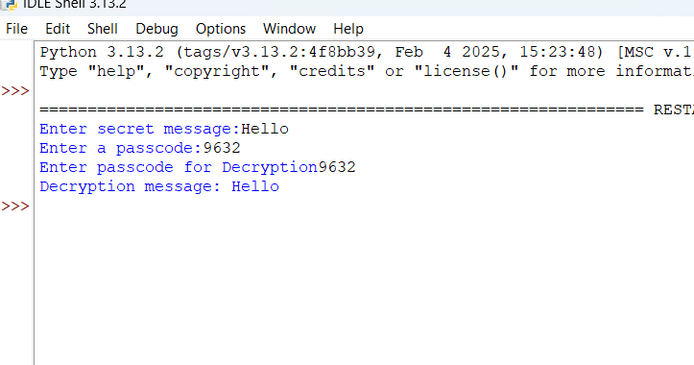

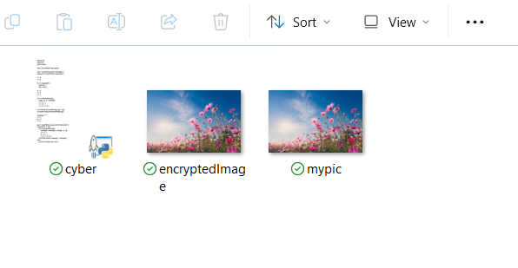
Results
Fig 1: Output
Fig 2 : encrypted img
Fig 3: File

Slide 8
Conclusion
Secure data hiding in images using steganography plays a vital role in ensuring confidentiality and privacy in an increasingly digital world. By embedding hidden information within image files in a way that is imperceptible to the human eye, steganography offers a powerful tool for secure communication and information protection. However, as the field continues to evolve, future advancements will focus on improving the robustness, efficiency, and security of these techniques.
Key areas for future development include the integration of AI and machine learning to enhance data hiding algorithms, resilience against attacks such as compression and noise, and the exploration of more advanced methods for high-resolution and 3D data. Additionally, combining steganography with watermarking can help offer a more holistic approach to both data security and authentication.
Ultimately, as new steganographic techniques emerge and become more sophisticated, the ability to securely hide data in images will continue to evolve, presenting opportunities for both improving privacy and addressing the increasing challenges posed by digital surveillance, data breaches, and cyber threats.

Slide 9
GitHub Link
https://github.com/Sahanack26/myaicte_project.git

Slide 10
Future scope(optional)
Enhanced Security Mechanisms
Robustness Against Steganalysis: Future work could involve developing methods to make steganography more resistant to steganalysis techniques (methods used to detect hidden information). This includes researching new algorithms that obscure the presence of hidden data better than current methods (e.g., advanced image transformations or encryption techniques combined with steganography).
Use of Encryption in Steganography: While traditional steganography hides data within images, combining encryption with steganography can further secure the hidden information. Future work could focus on the development of hybrid methods, where data is first encrypted and then embedded into images using sophisticated steganographic techniques.

Slide 11
THANK YOU

